Slide 1
Spring Boot + Microservices
Vivek Gohil

Slide 2




What are Microservices ?
To understand microservices, lets imagine a bank called EazyBank.
Typically, banks comprise various departments, including Accounts, Cards, Loans.

Slide 3
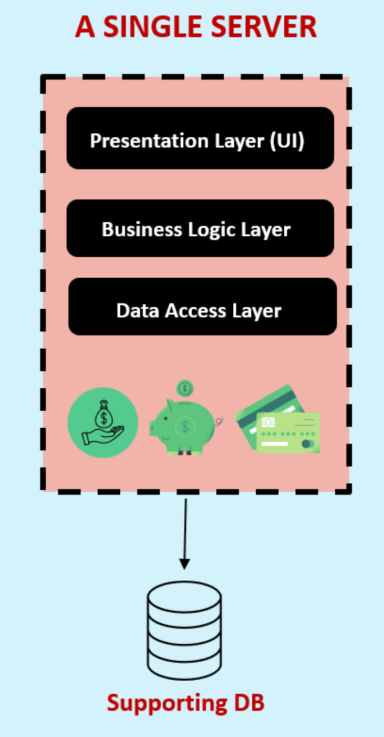
The Monolith
Back a decade, all the applications used to be deployed as a single unit where all functionality deployed together inside a single server.
We call this architecture approach as Monolithic.

Slide 4
The Monolith
Pros
Cons
Simple development and deployment for smaller teams and applications
Fewer cross-cutting concerns
Better performance due to no network latency
Difficult to adopt new technologies
Limited agility
Single code base and difficult to maintain
No fault tolerance
Tiny update and feature development always need full deployment

Slide 5

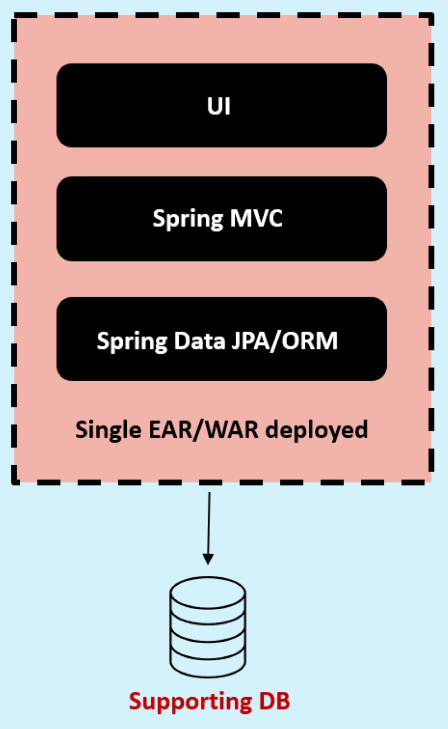





The Monolith
Accounts Dev Team
Single Code Repo
CI/CD
Loans Dev Team
In a monolithic approach, developers work with single code base which is then packed as unified unit, such as an EAR/WAR file and deployed into a single web/application server. Additionally the entire application is supported by a single database.
Cards Dev Team
UI/UX Dev Team

Slide 6
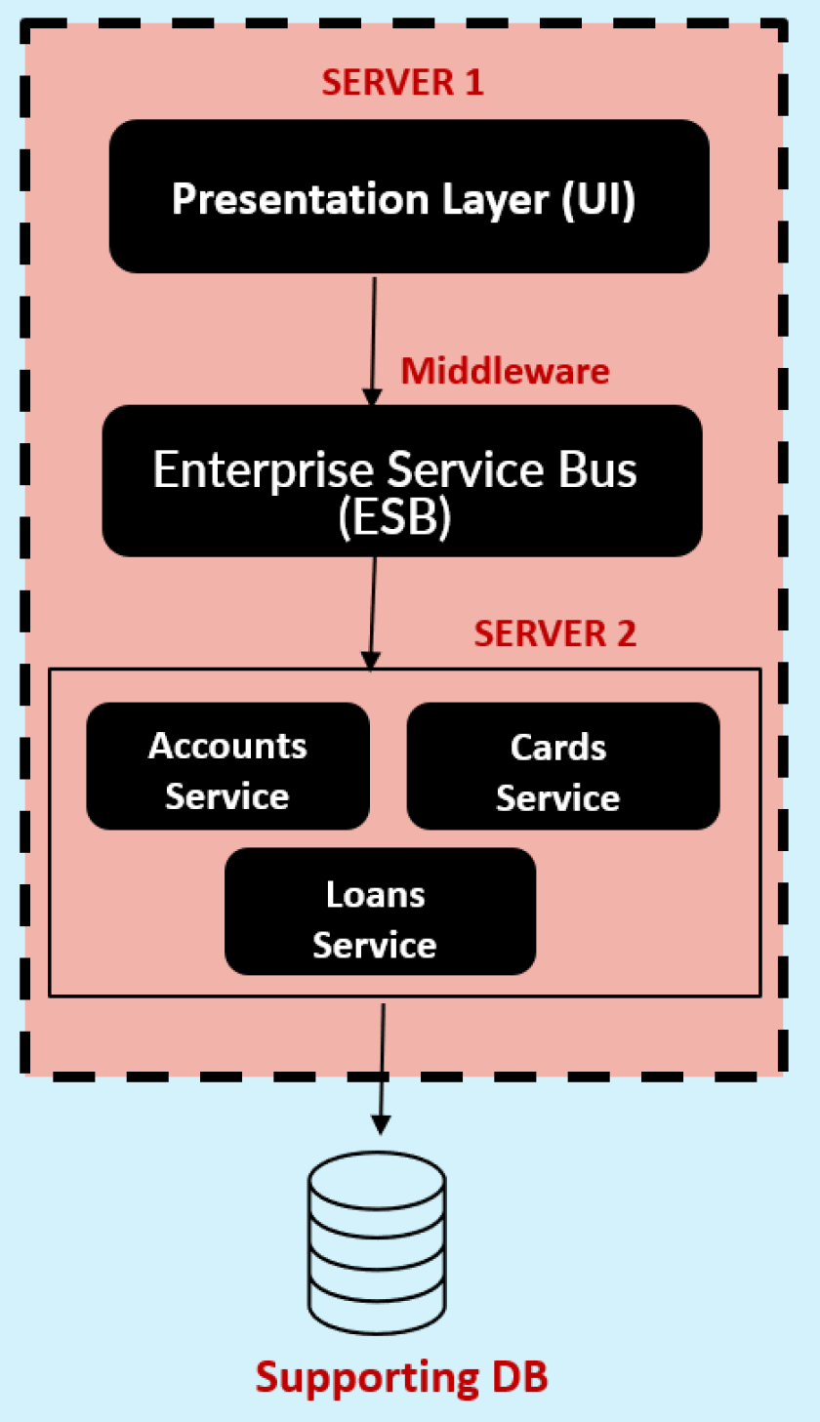
The SOA (Service-Oriented Architecture)
SOA emerged as an approach to combat the challenges of large, monolithic applications.
It is an architectural style that focuses on organizing software systems as a collection of loosely coupled, interoperable services.
It provides a way to design and develop large-scale applications by decomposing them into smaller, modular services that can be independently developed, deployed and managed.

Slide 7
The SOA (Service Oriented Architecture)
Pros
Cons
Reusability of services
Better maintainability
Higher reliability
Parallel development
Complex management due to communication protocols(SOAP).
High investment costs due to vendor in middleware
Extra overload

Slide 8


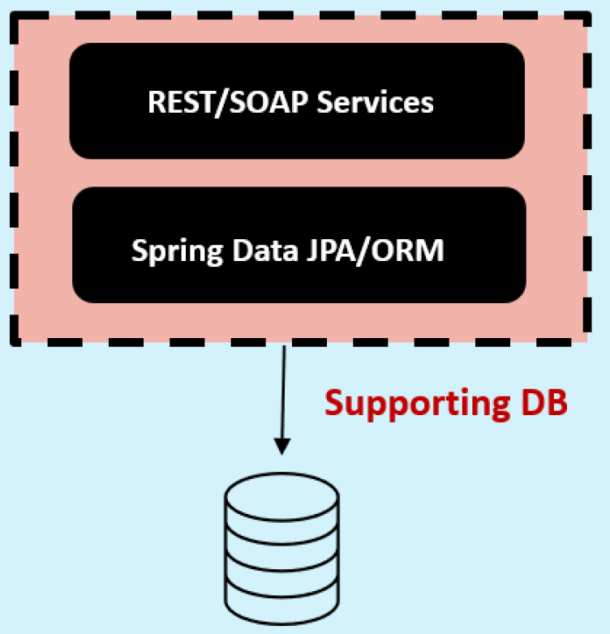
The SOA (Service Oriented Architecture)
UI/UX Dev Team
UI code repo
Loans Dev Team
Cards Dev Team
Backend Services repo
SOA teams aimed to create smaller services, yet they remained tightly coupled to a shared database and required deploying everything as cohesive unit. While they followed a service oriented approach, it cannot be classified as microservices.
Accounts Dev Team

Slide 9
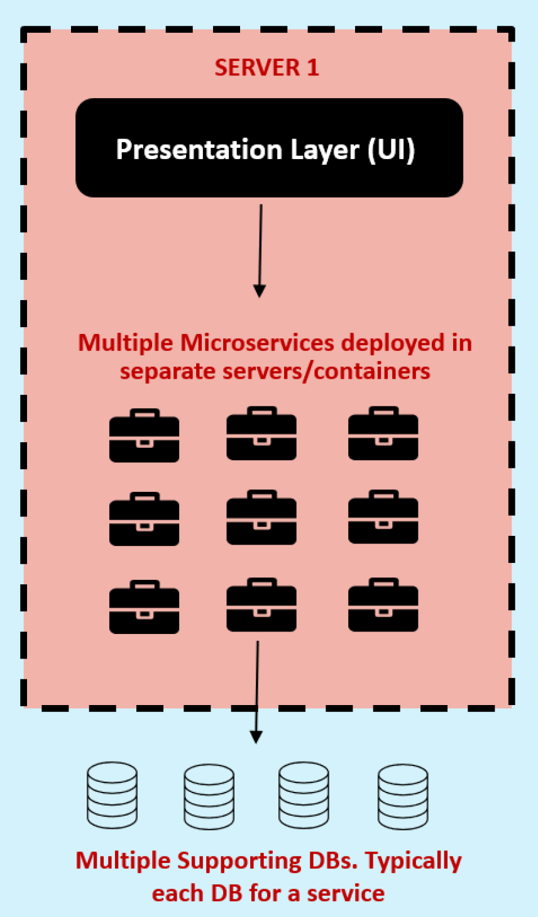
The Great Microservices
Microservices are independently releasable services that are modelled around business domain.
A service encapsulates functionality and makes it accessible to other services via networks – you construct more complex systems from these building blocks.
One microservice might represents Accounts, another Cards and yet another Loans, but together they might constitute an entire bank system.

Slide 10
The Great Microservices
Pros
Cons
Easy to develop, test and deploy
Increased agility
Ability to scale horizontally
Parallel development
Modelled around a business domain
Complexity
Infrastructure overhead
Security concerns

Slide 11


The Great Microservices
Invokes all the backend logic through REST API calls
UI APP
UI/UX Dev Team
Loans Dev Team
Loans DB
Cards Dev Team
Cards DB
Accounts Dev Team
Accounts DB

Slide 12
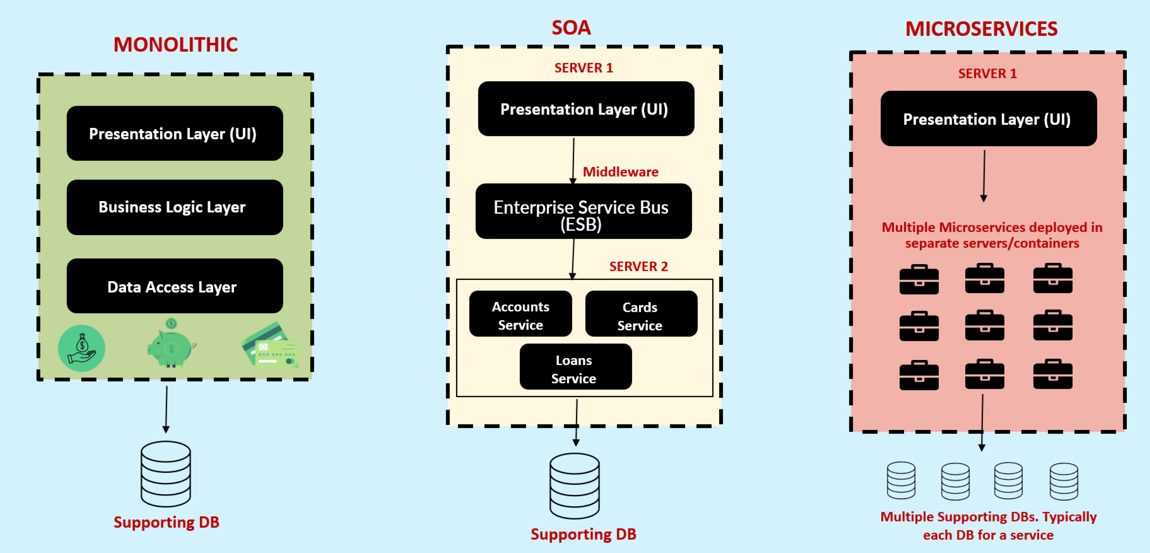
Monolithic vs SOA vs Microservices

Slide 13
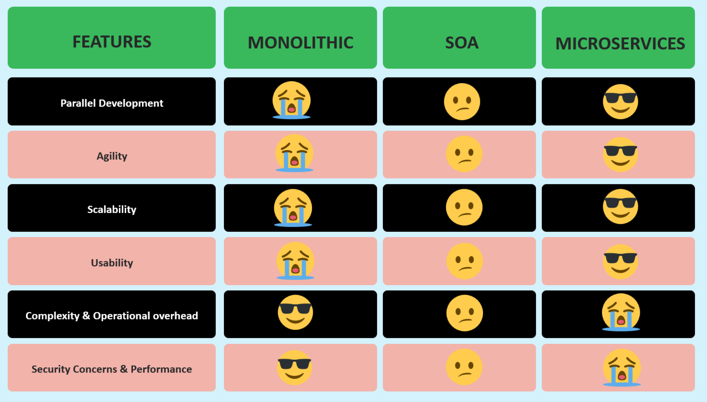
Monolithic vs SOA vs Microservices

Slide 14

Definition of Microservices ?
“Microservices is an approach to developing a single application as a suite of small services, each running in its own process and communicating with lightweight mechanisms, built around business capabilities and independently deployable by fully automated deployment machinery.” – From Article by James Lewis and Martin Fowler’s

Slide 15

How to build Microservices ?
When considering a web application, the traditional approach involves packaging it as WAR or EAR file.
These archive formats are commonly used to build Java applications, which are then deployed to web servers like Tomcat.
Do you think the same approach works for building microservices ?

Slide 16

How to build Microservices ?
Off course not, because organizations may need to build 100s of microservices. Building, packaging and deploying all the microservices using traditional methods can be an extremely challenging and practically impossible task.
How to overcome this challenge ?
The clue is Spring Boot

Slide 17
Why Spring Boot for Microservices ?
Spring Boot is a framework that simplifies the development and deployment of Java/Spring applications, including microservices.
With Spring Boot, you can build self-contained, executable JAR files instead of traditional WAR or EAR files.
Theses JAR files contains all the dependencies and configurations required to the microservices.
This approach eliminates the need for external web servers.

Slide 18
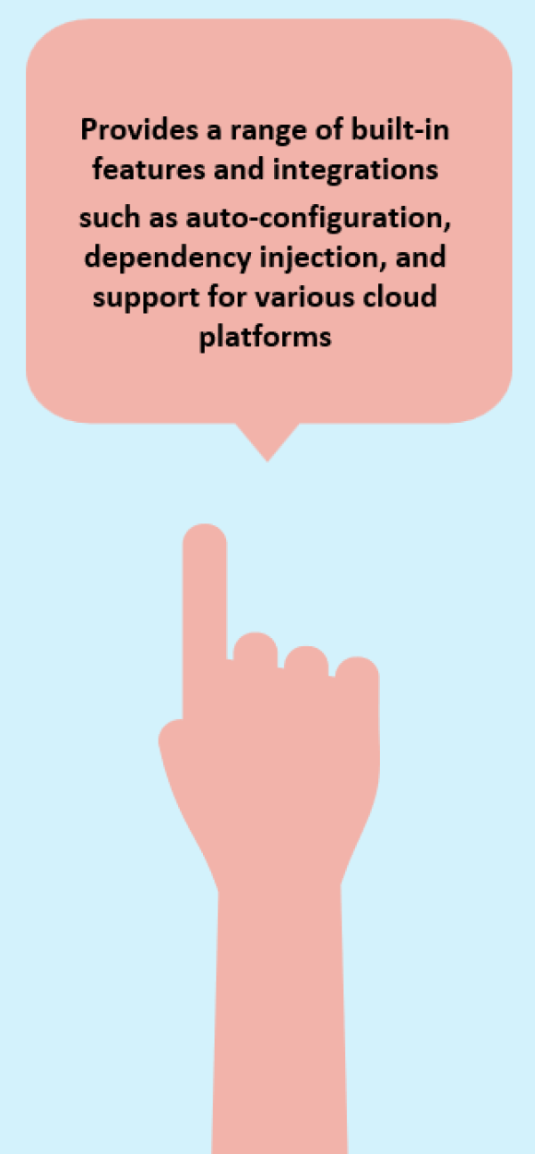
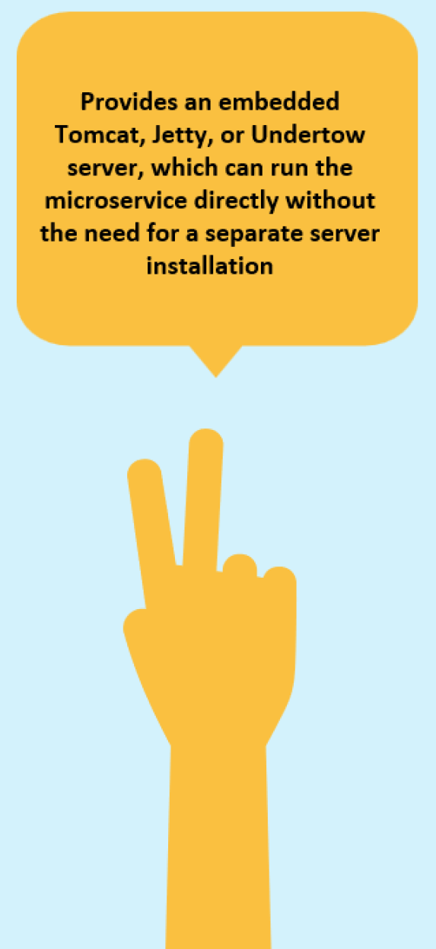

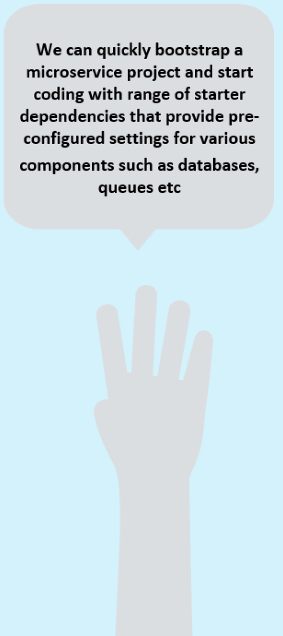
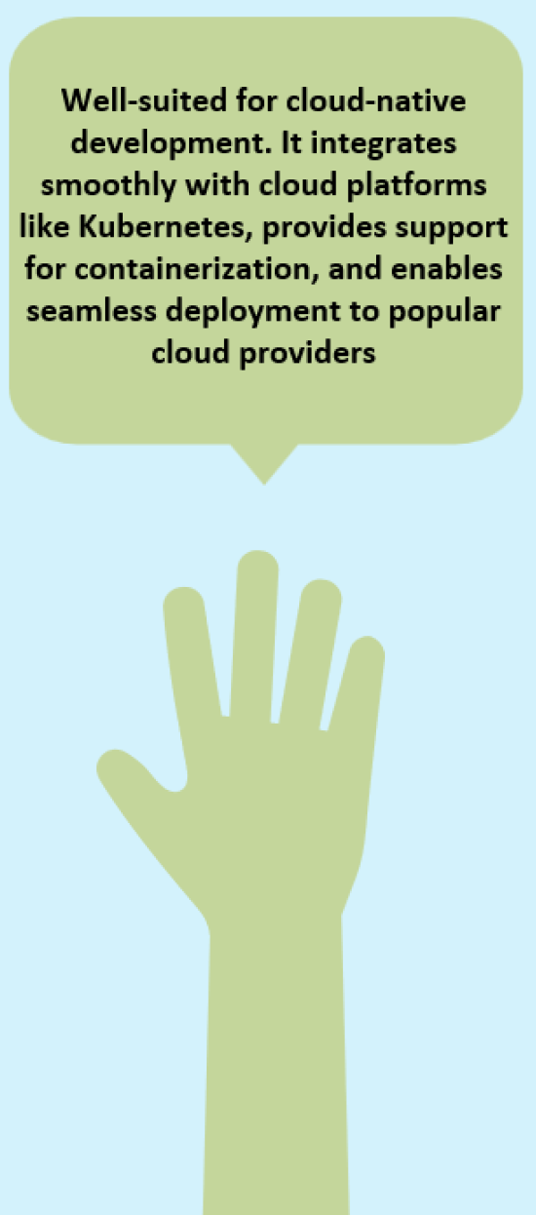
Why Spring Boot for Microservices ?

Slide 19
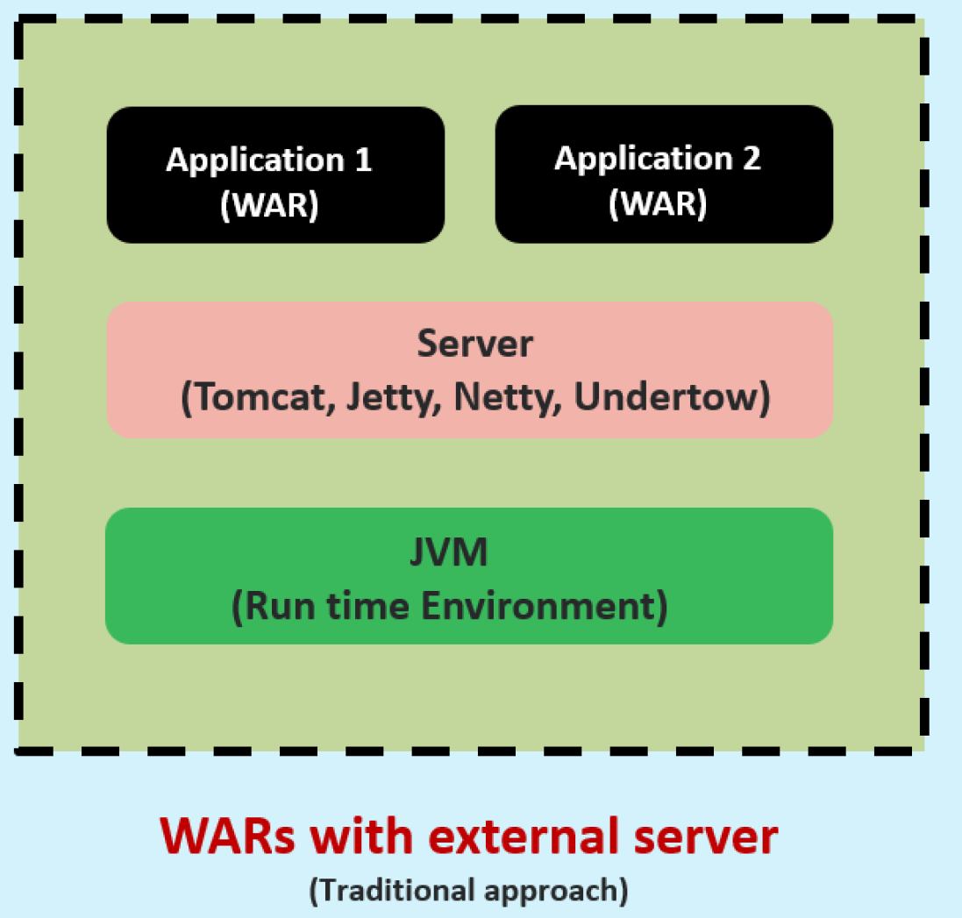
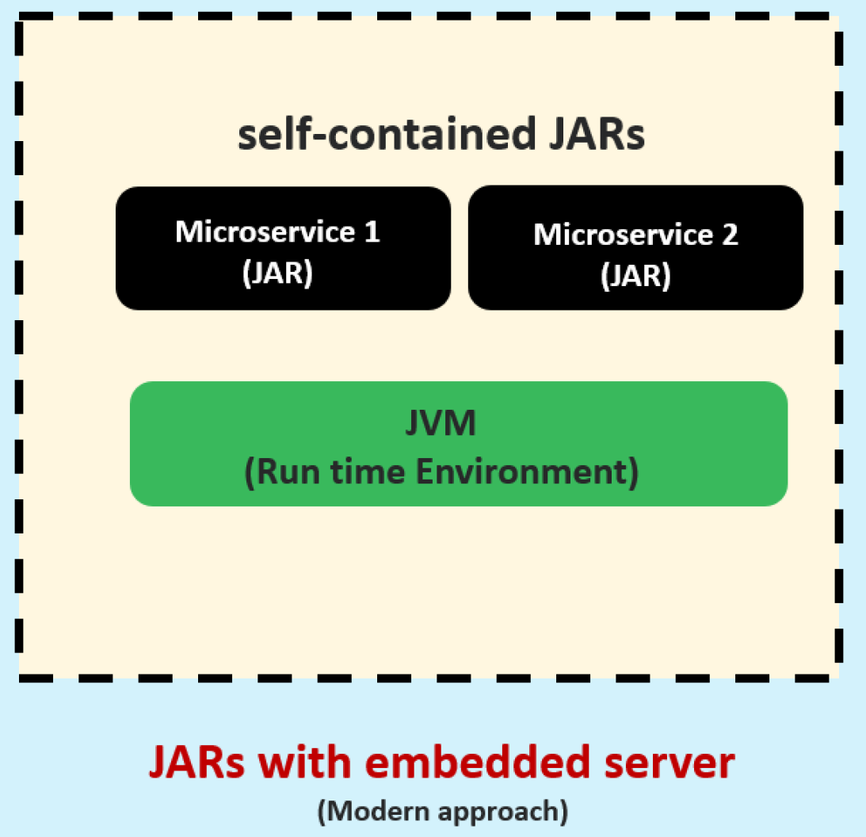
Why Spring Boot for Microservices ?
In the traditional approach, applications are typically packed as WARs and rely on the presence of a server in the execution environment for running. However, in the microservices paradigm, applications are packed as self-contained JARs, also called fat-JAR, since they contain the application itself, the dependencies and the embedded server

Slide 20
Implementing REST Services
REST (Representational State Transfer) services are one of the most often encountered ways to implement communication between two web apps.
REST offers access to functionality the server exposes through endpoints a client can call.

Slide 21
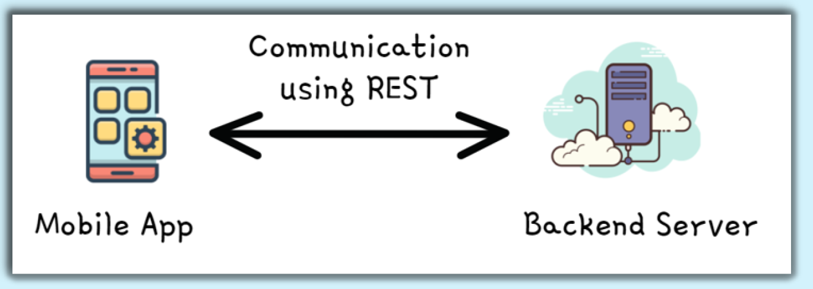
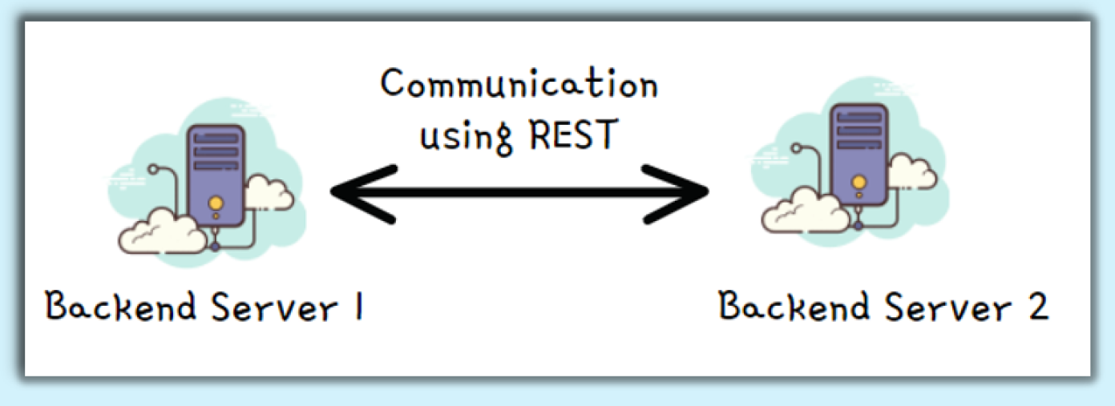
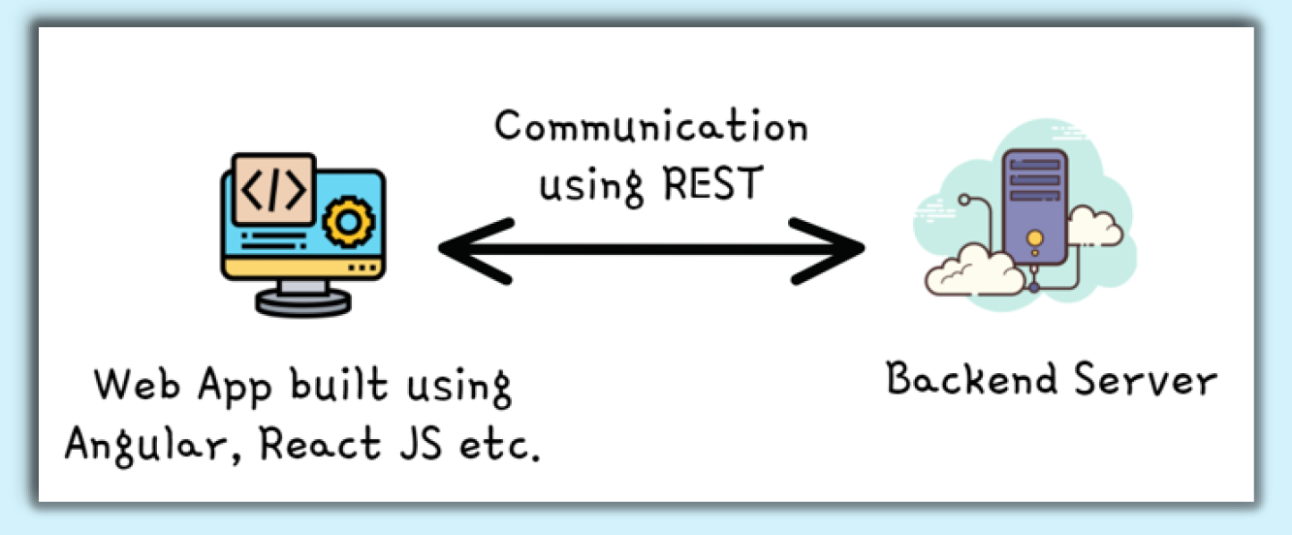
Implementing REST Service
Below are the different use cases where REST services are being used most frequently these days.

Slide 22
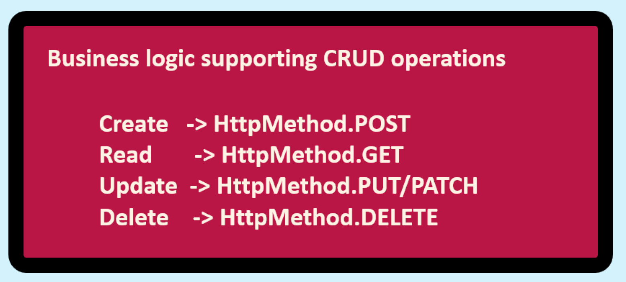
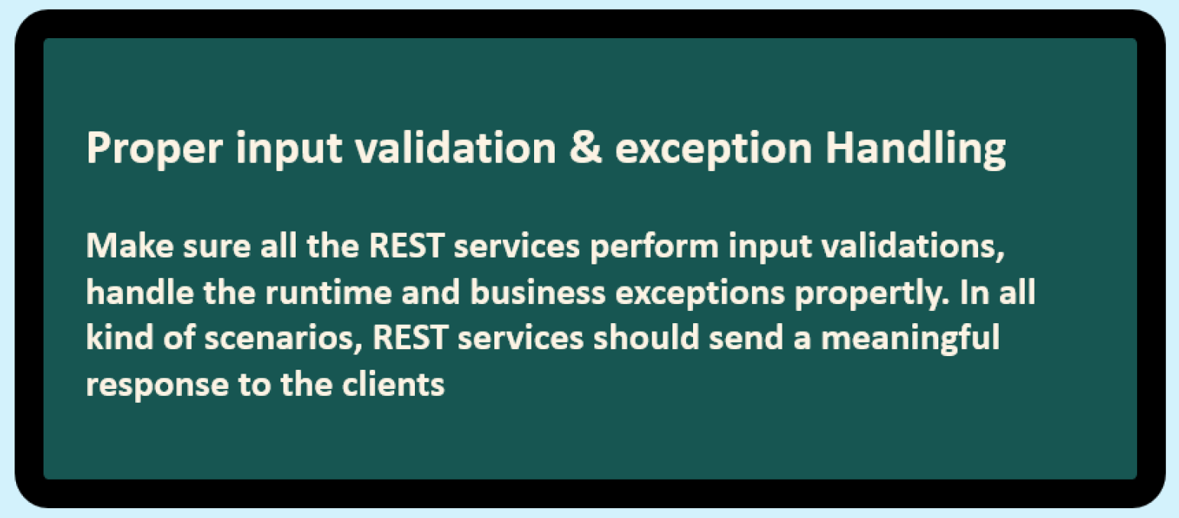
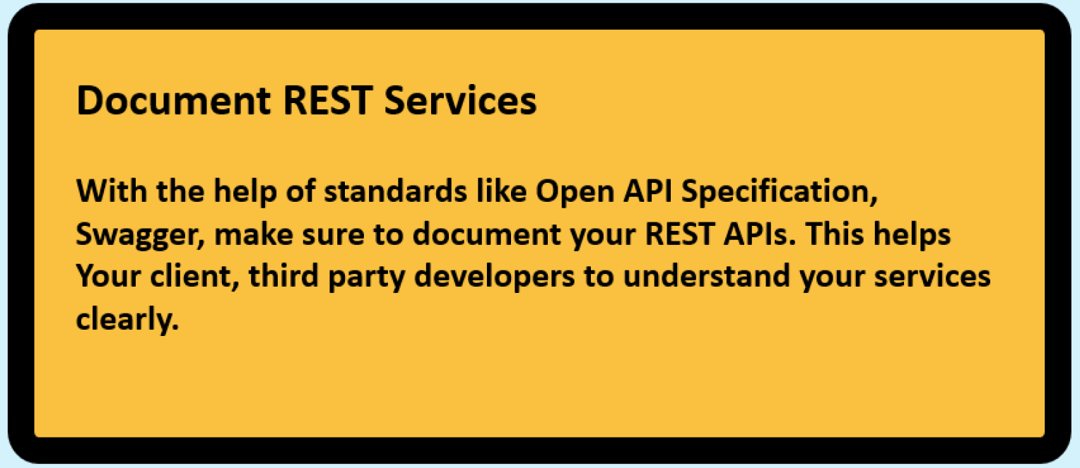
Implementing REST Service
Typically REST services are built to expose the business functionality and support CRUD operations on the storage system.
Attached are the standards that we need to follow while build REST services.

Slide 23
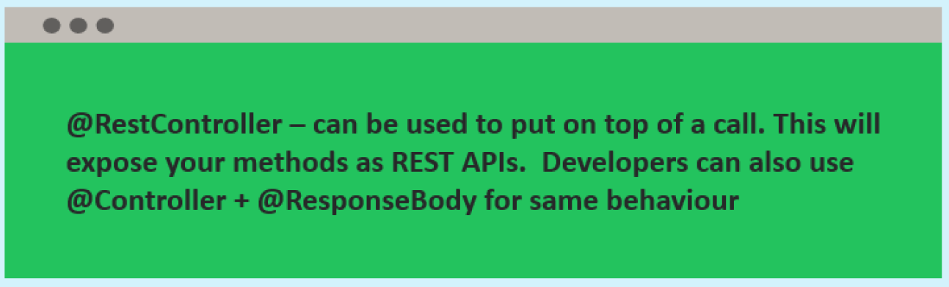
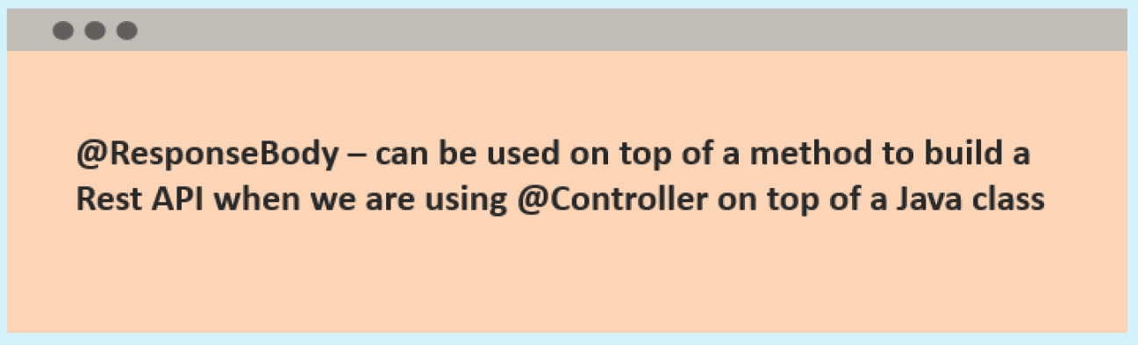
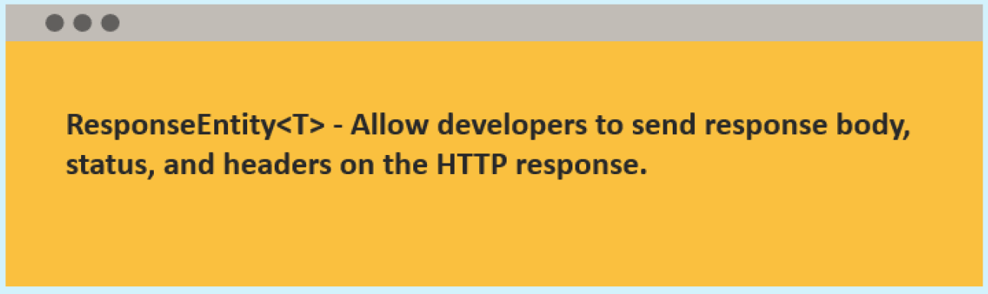
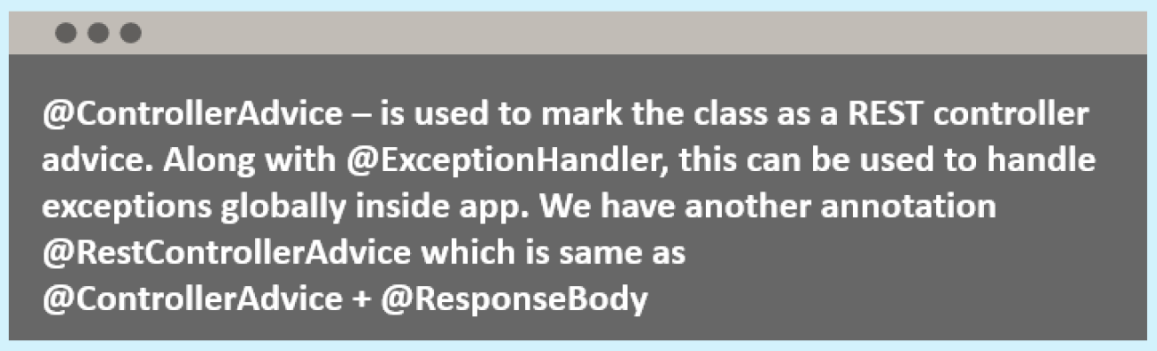


Different Annotations & Classes that supports building REST Services

Slide 24
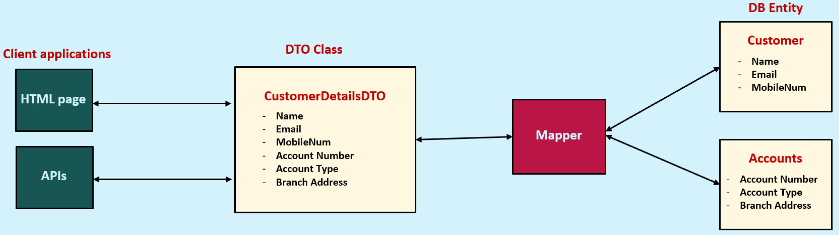
DTO (Data Transfer Object) Pattern
The Data Transfer Object(DTO) pattern is a design pattern that allows you to transfer data between different parts of your application.
DTOs are simple objects that contain only data, and they do not contain any business logic.
This makes them ideal for transferring data between layers of your application, such as the presentation layer and data access layer.

Slide 25
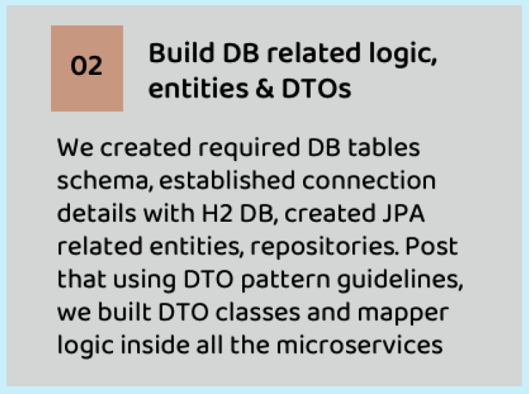
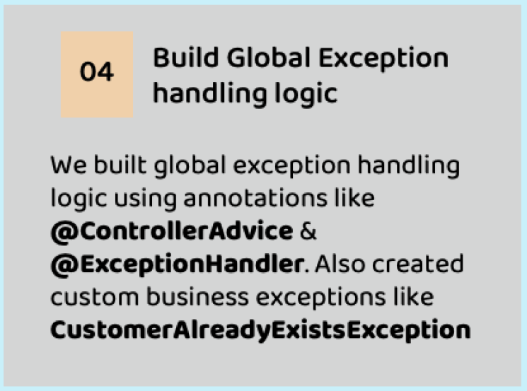
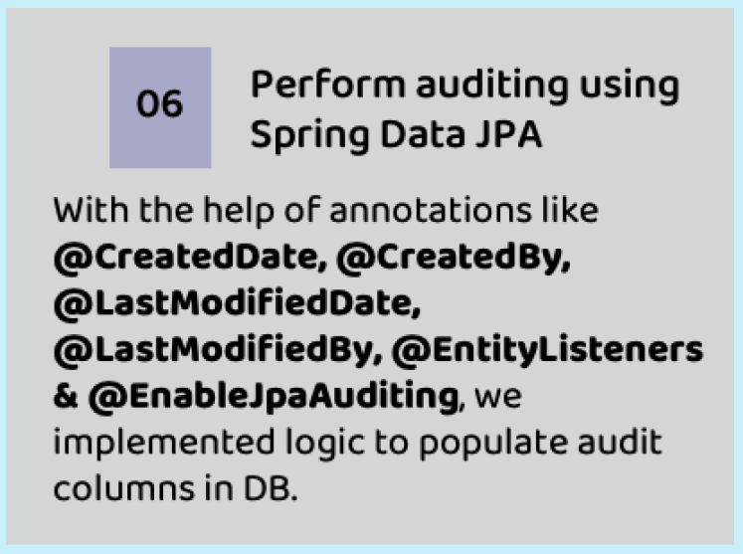
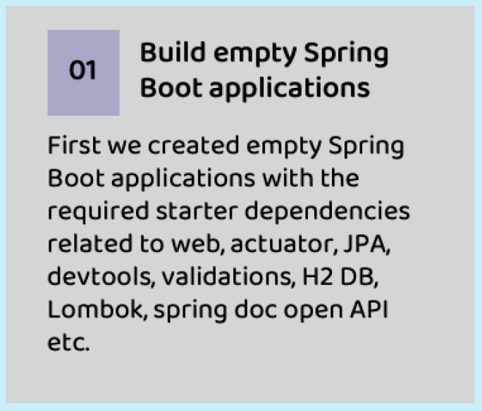
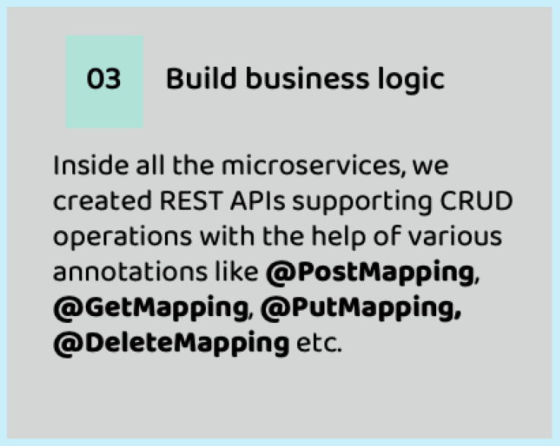
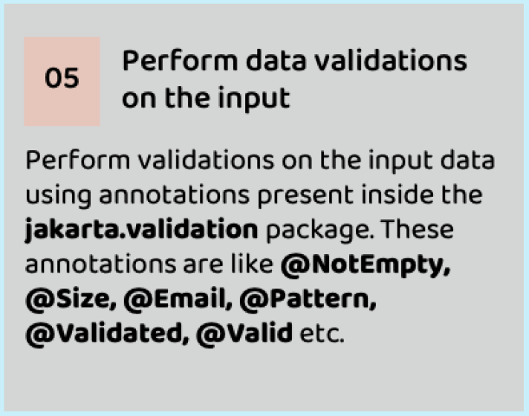
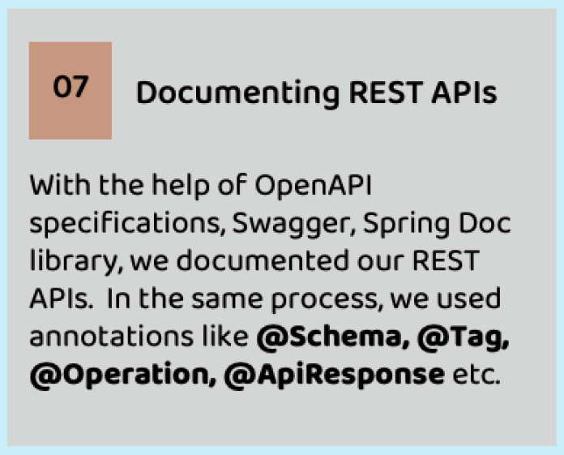
Summary of the steps followed to build Microservices

Slide 26
What are cloud native applications ?
Cloud-native applications are software application designed specifically to leverage cloud computing principles and take full advantage of cloud-native technologies and services.
These applications are built and optimized to run in cloud environments, utilizing the scalability elasticity and flexibility offered by the cloud.

Slide 27
Development Principles of Cloud Native applications
How to get succeeded in building Cloud Native Apps and what are the guiding principles that can be considered for the same ?
The engineering team at Heroku cloud platform introduced the 15 factor mythology, a set of development principles aimed at guiding the design and construction of cloud-native applications.

Slide 28
15 – Factor Methodology
One codebase, one application
API First
Dependency Management
Design, build, release, run
Configuration, Credentials & Code
Logs
Disposability
Backing Services
Environment parity
Administrative processes
Port binding
Stateless processes
Concurrency
Telemetry
Authentication and authorization

Slide 29
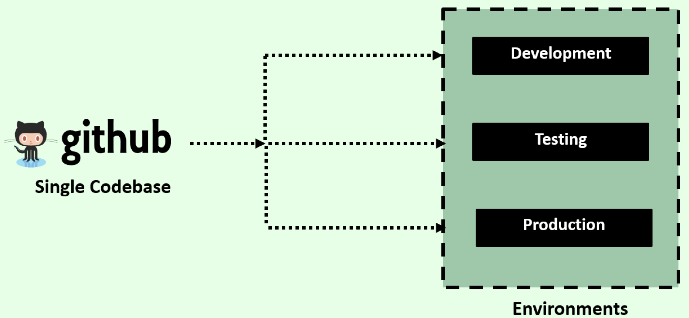
1. One codebase, one application
The 15-Factor methodology ensures a one-to-one correspondence between an application and its codebase, meaning each application has a dedicated codebase.
Shared code is managed separately as a library, allowing it to be utilized as a dependency or as a standalone service, serving as a backing service for other applications.
It is possible to track each codebase in its own repository, providing flexibility and organization of codebase.

Slide 30
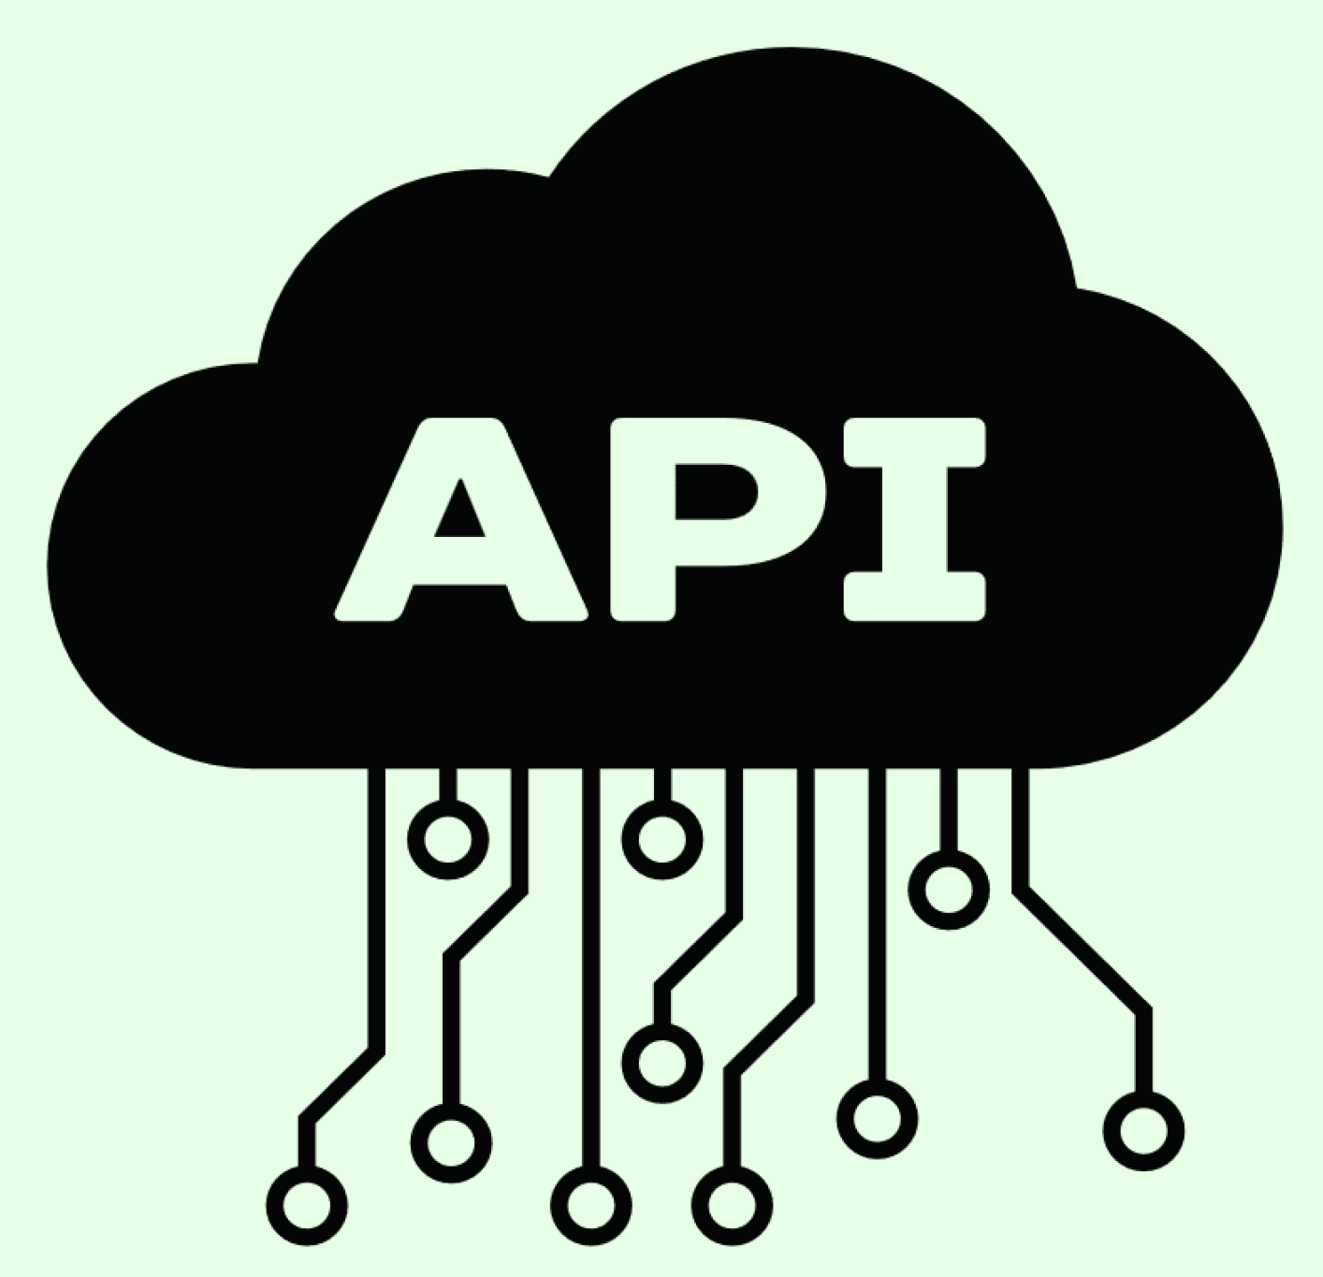
2. API First
In a cloud-native ecosystem, a typical setup consists of various services that interact through APIs.
Adopting an API-First approach during the design phase of a cloud-native application encourages a mindset aligned with distributed systems and promotes the division of work among multiple teams.
Designing the API as a priority allows other teams to build their solutions based on that API when using application as backing service.

Slide 31
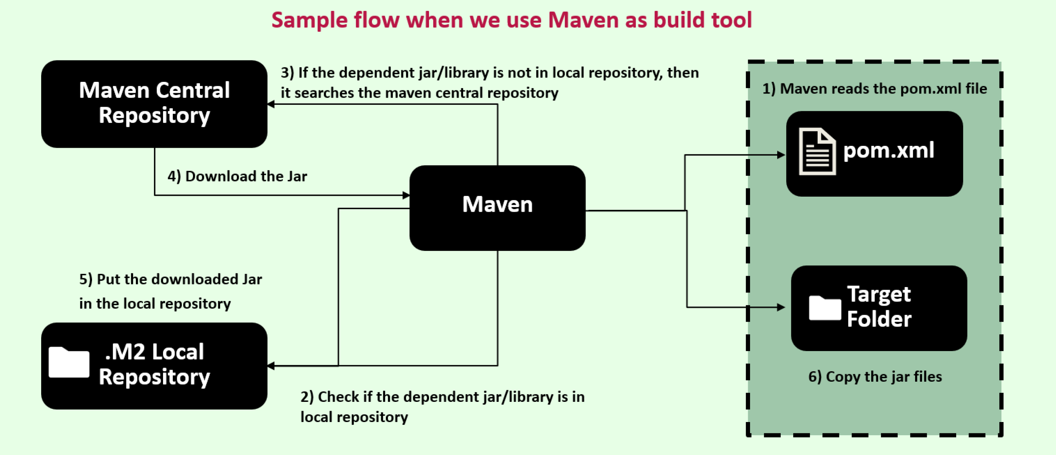
3. Dependency Management
Its is crucial to explicitly declare all dependencies of an application in a manifest and ensure that they are accessible to the dependency manager, which can download them from a central repository

Slide 32
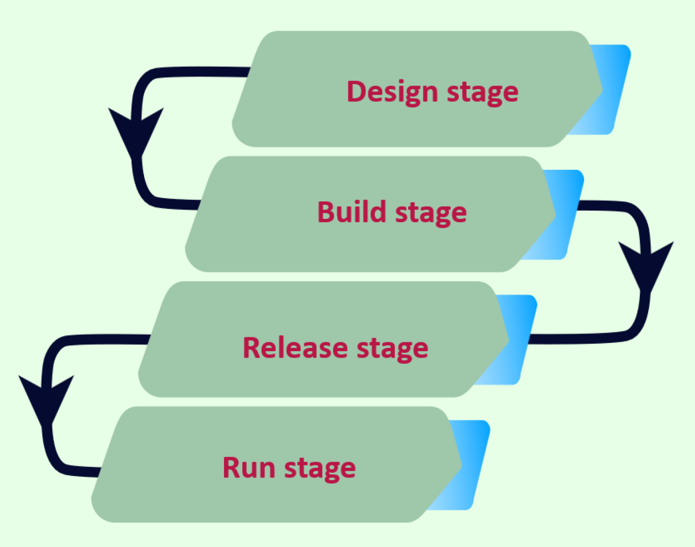
4. Design, build, release, run
Codebase progression from design to production deployment involves below stages
Design Stage
Build Stage
Release Stage
Run Stage

Slide 33
4. Design, build, release, run
Design State
Determine technologies, dependencies and tools for specific application feature
Build Stage
Compile and package the codebase with dependencies, creating an immutable artifact(build)
Release Stage
Combine the build with a specific deployment configuration. Each release is immutable and uniquely identifiable, such as through semantic versioning.
Run State
Execute the application in the designated runtime environment using a specific release.

Slide 34
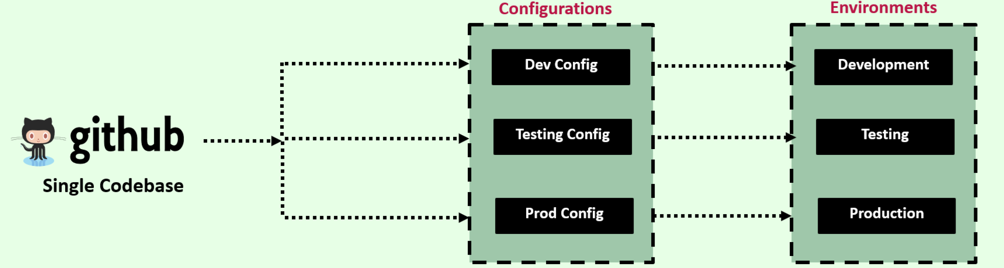
5. Configuration, Credentials & Code
According to the 15 Factor methodology, configuration encompasses all elements prone to change between deployments.
It emphasizes the ability to modify application configuration independently, without code changes or need to rebuild the application.
Configuration may include resource handles for backing services, credentials for accessing third party APIs and feature flags.
It is essential to evaluate whether any confidential or environmental or environment-specific information would be at risk if the codebase were exposed publicly.
This configuration ensures proper externalization of configuration.

Slide 35
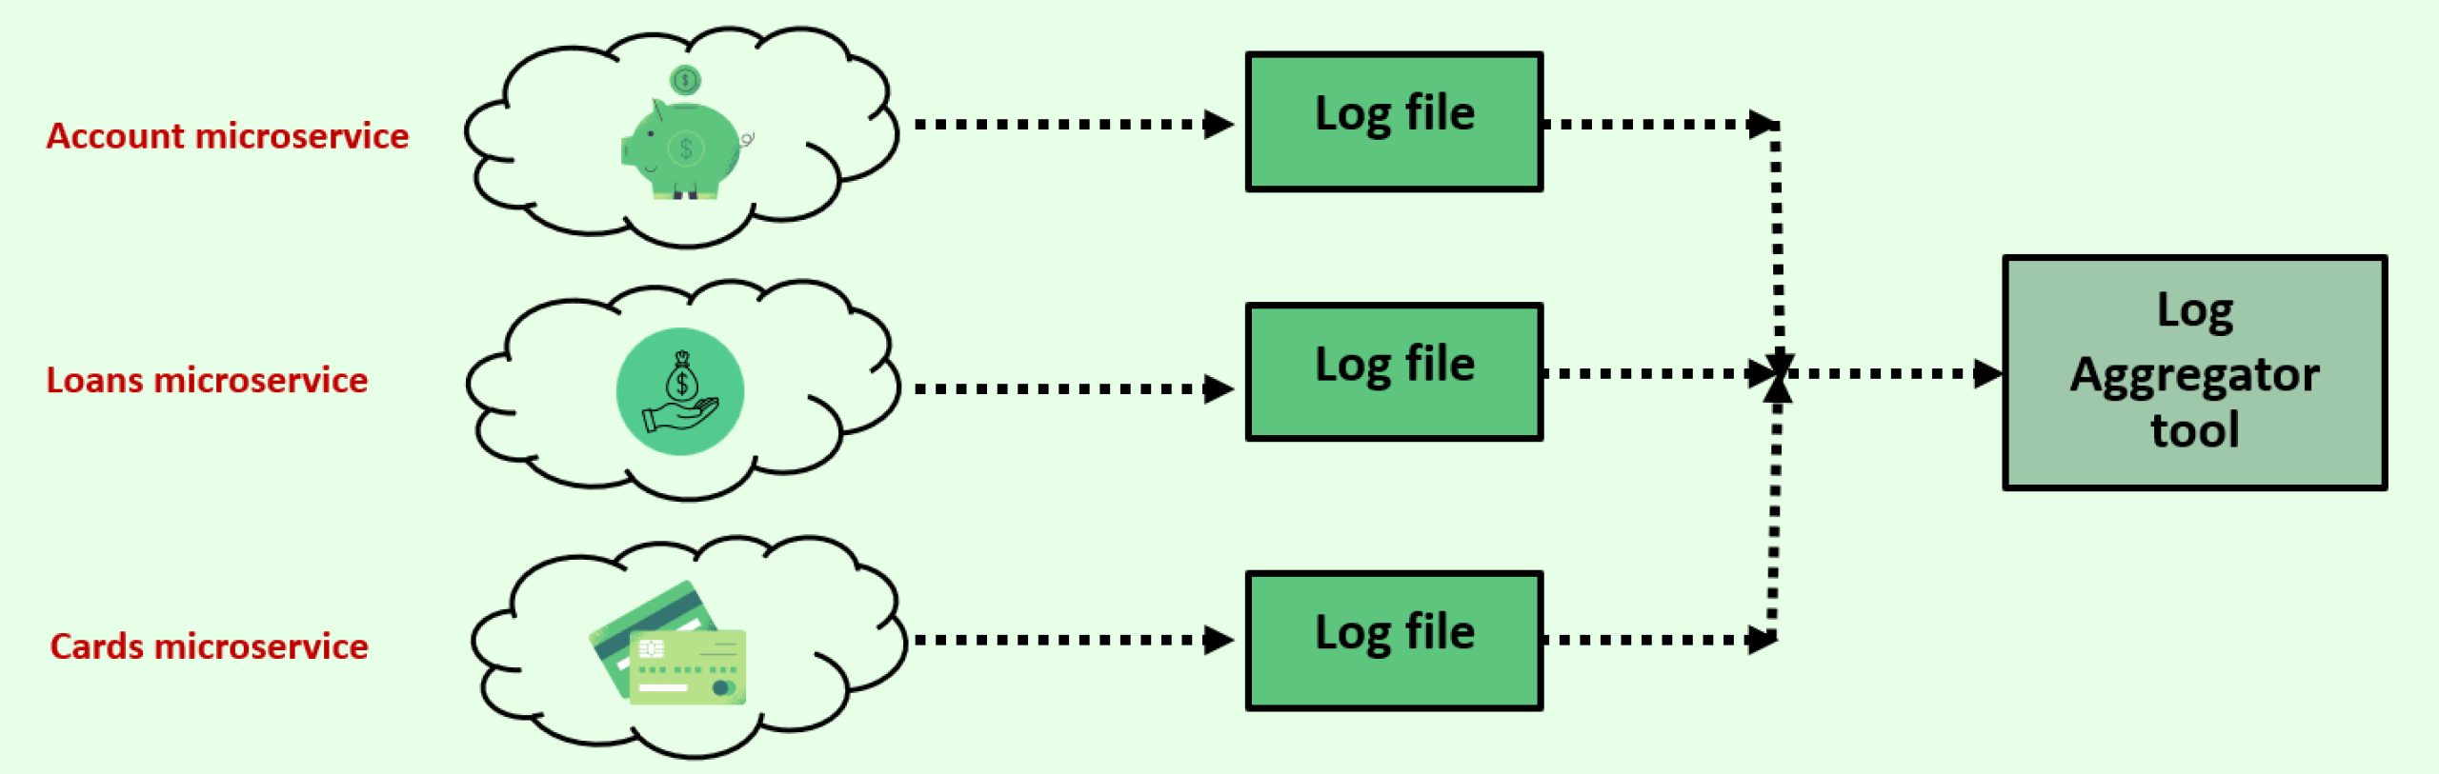
6. Logs
In a cloud-native application, log routing and storage are not the application’s concern.
Instead, applications should direct their logs to the standard output, treating them as sequentially ordered events based on time.
The responsibility of log storage and rotation is now shifted to an external tool, known as a log aggregator.

Slide 36

7. Disposability
This concept is referred to as application disposability, When applications can be started or stopped as needed.
Docker containers along with an orchestrator Kubernetes inherently satisfy this requirement.

Slide 37

8. Backing Services
Backing services refer to external resources that an application relies on to provide its functionality.
These resources can include databases, message brokers, caching systems, SMTP services, FTP servers and RESTful web services.
By treating these services as attached resources, you can modify or replace them without needing to make changes to the application code.

Slide 38

9. Environment Parity
Environment parity aims to minimize difference between various environments and avoiding costly shortcuts.
Here are the adoption of containers can greatly contribute by promoting the same execution environment.
There are three gap that this factor addresses
Time gap
People gap
Tools gap

Slide 39
9. Environment Parity
Time gap
The time it takes for a code change to deployed can be significant. The methodology encourages automation and continues deployment to reduce the time between code development and production deployment
People gap
Developers create applications, while operators handle their deployment in production. To bridge this gap a DevOps culture promotes collaboration between developers and operators, fostering the “You build it, you run it”
Tools gap
Handling of backing services differs across environments. For instance, developers might use the H2 database locally but PostgreSQL in production. To achieve environment parity, it is recommended to use the same type and version of backing services across all envrionment

Slide 40

10. Administrative Process
Management tasks required to support application, such as database migration, batch jobs or maintenance tasks, should be treated as isolated processes.
Similar to application processes, the code for these administrative tasks should be version controlled, pack alongside the application and executed with the same environment.

Slide 41

11. Port Binding
Cloud native applications should be self-contained and expose their services through port binding.
In production environment, routing services may be employed to translate requests from public endpoints to the internally pro-bond services.

Slide 42

12. Stateless process
One of the key principles to achieve scalability is designing application as stateless process and adopting a share-nothing architecture.
This means that no state should be shared among different instances of application.
It is important to evaluate whether any data would be lost if an instance of the application is destroyed and recreated.
If data loss occurred, the application is not truly stateless.

Slide 43
13. Concurrency
Scalability is required to serve a large number of users.
This means that applications should support concurrent processing to handle multiple users simultaneously.

Slide 44
14. Telemetry
Observability is a fundamental characteristic of cloud native applications.
Consider the kind of telemetry that would be necessary to ensure remote monitoring and control of your application.
This includes information such as detailed logs for troubleshooting, metrics to measure performance, traces to understand request flows, health status to assess system well-being and even to capture significant occurrences.

Slide 45

15. Authentication & Authorization
Authentication enables us to track and verify the identity of users accessing the application.
By authenticating users, we can evaluate their permissions and determine if they have the necessary authorization to perform specific actions.
Notable examples include Oauth 2.1, OpenId Connect , JWT

Slide 46

Configuration Management in Microservices
How do we separate the configurations/properties from the microservices so that same can be deployed on multiple environments ?
How do we inject configurations/properties that microservice needed during start up of the service ?
How do we maintain configurations/properties in a centralized repository along with versioning of them ?

Slide 47
Configuration Management in Microservices
There are multiple solutions available in Spring Boot
Configuring Spring Boot with properties and profiles
Applying external configuration with Spring Boot
Implementing a configuration server with Spring Cloud Config Server

Slide 48
How configurations are handled in traditional application ?
Traditional applications were typically bundled together with their source code and various configuration file that contained environment specific data.
This mean that updating the configuration required rebuilding the entire application or creating separate builds for each environment.
As a result, there was no guarantee that the application would behave consistently across different environments, leading to potential issues when moving from staging to production

Slide 49
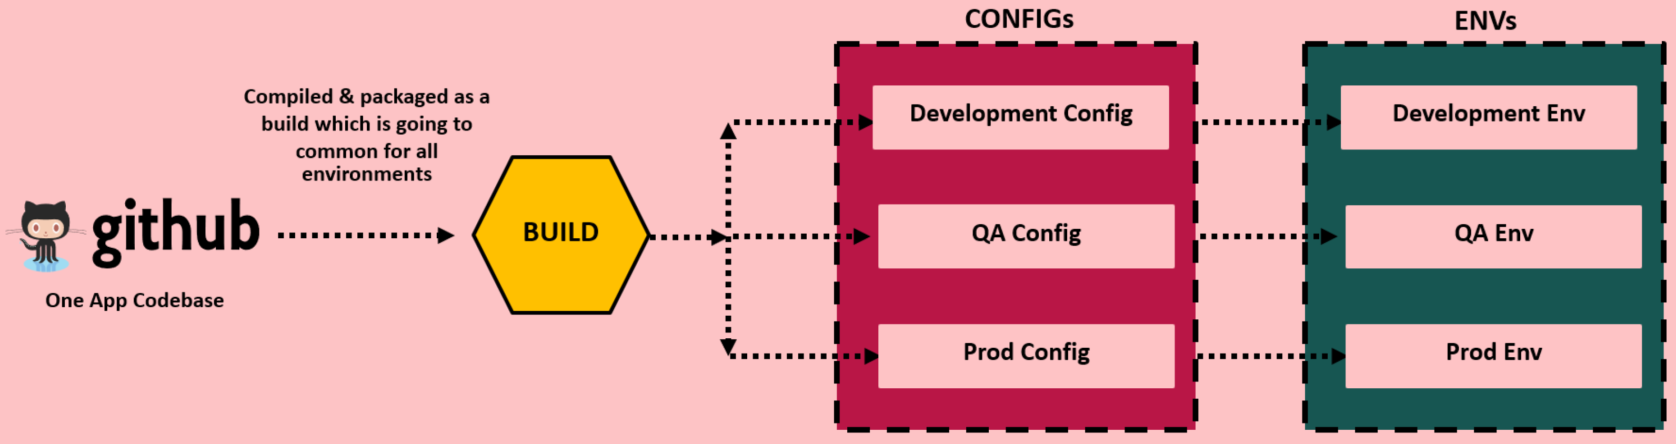
How configurations are handled in traditional application ?
According to the 15-Factor methodology, configuration encompasses any element likely to change between deployments such as credentials, resource handles and service URLs.
Cloud native applications address this challenge by maintaining the immutability of the application artifact across environments.
Regardless of the deployment, the application build remains unchanged.
In cloud native applications, each deployment involves combining the build with specific configuration data.
This allows the same build to be deployed to multiple environments while accommodating different configurations.

Slide 50
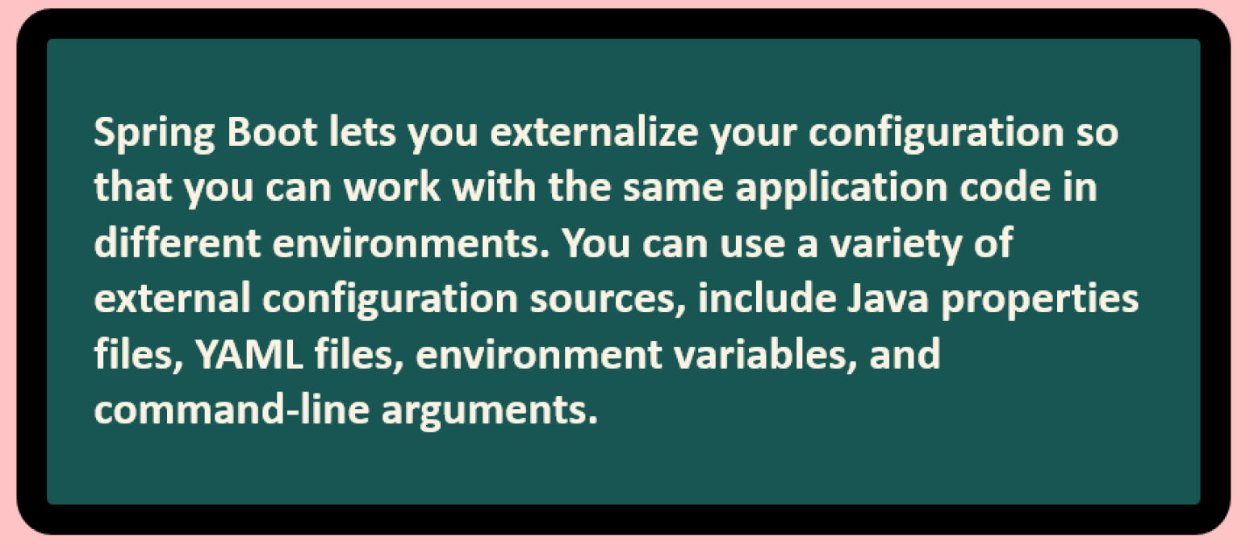
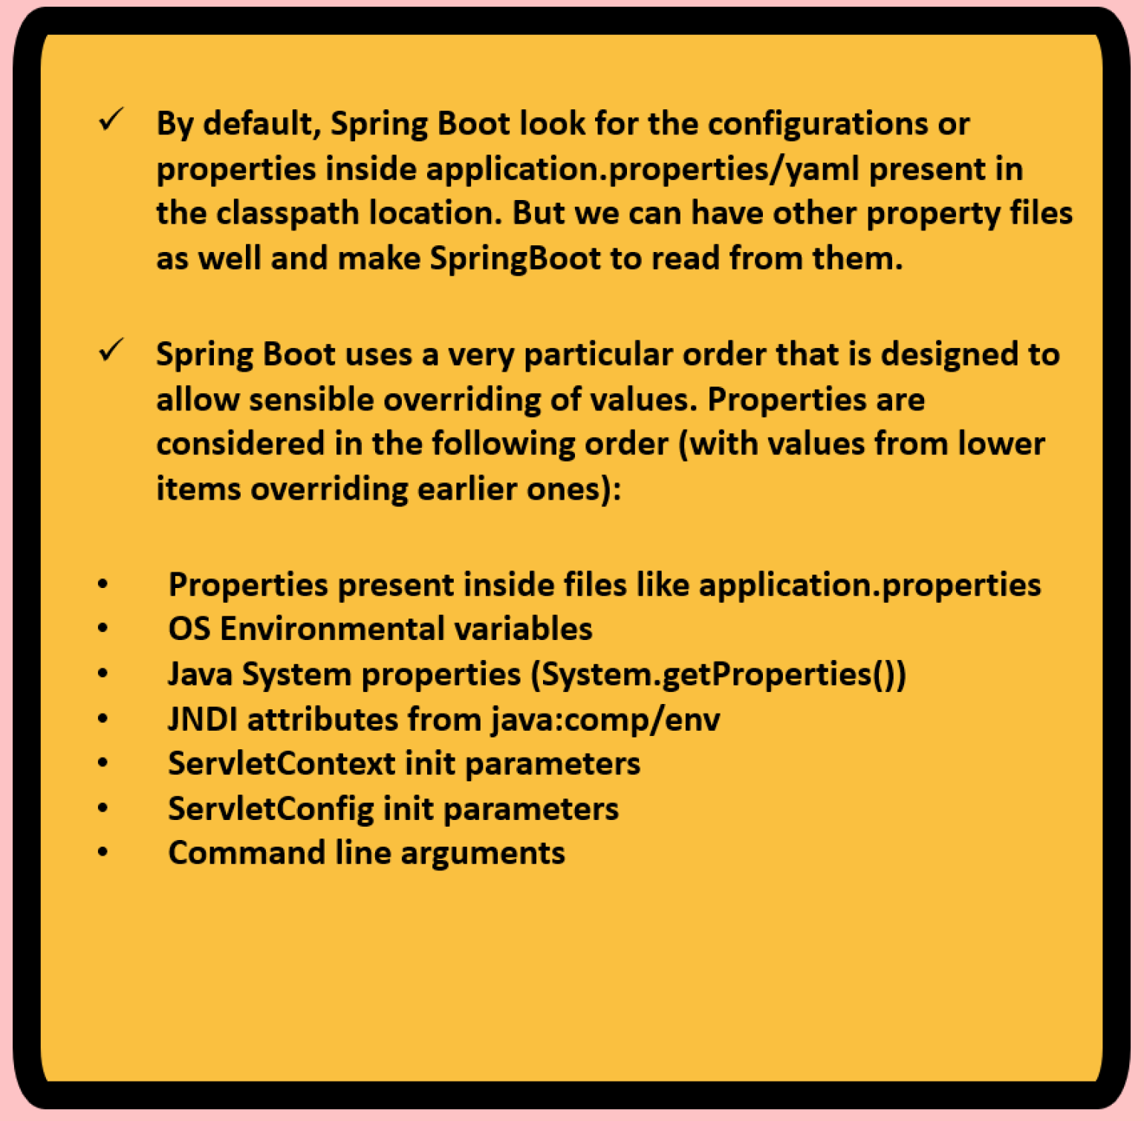
How Configurations work in Spring Boot ?

Slide 51
How to read properties in Spring Boot
@Value
You can use @Value annotation to directly inject properties into beans.
This approach is suitable for injecting individual properties into specific fields.
Environment
The environment interface provides methods to access properties from the applications environment.
You can autowire the Environment bean and use its method to retrieve property values.
@ConfigurationProperties
@ConfigurationProperties annotation enables binding of entire groups of properties to bean.
You define configuration class with annotated fields matching properties and Spring Boot automatically maps properties to field.

Slide 52
Profiles
Spring provides a great tools for grouping configuration properties into so-called profiles(dev, qa, prod) allowing us to activate a bunch of configurations based on the active profile.
Profiles are perfect for setting up our application for different environments, but they’re also being used in another use cases like bean creation based on a profile etc.
So basically, a profile can influence the application properties loaded and beans which are loaded into the Spring Context.

